Slide 1


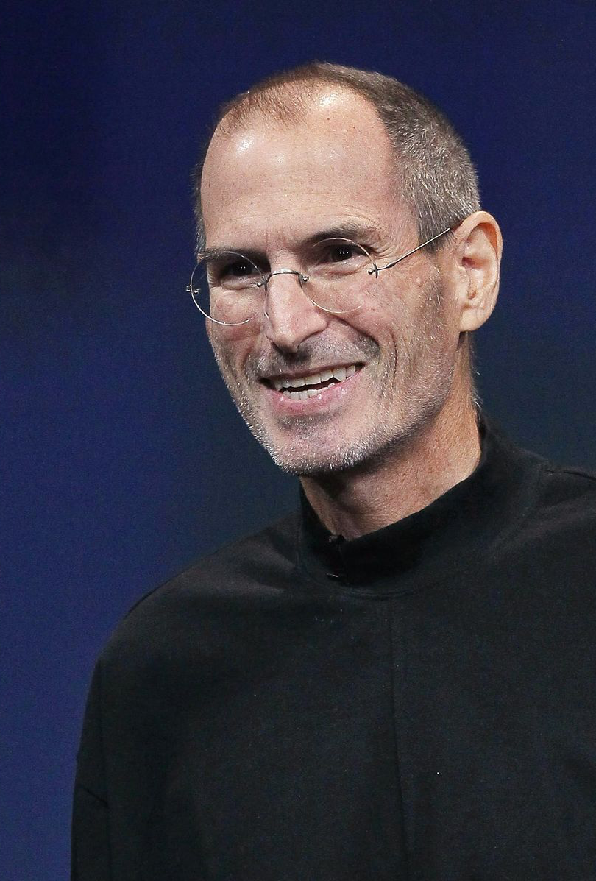

Steve Jobs
Made By Kókai Balázs and Nyers Donát

Slide 2
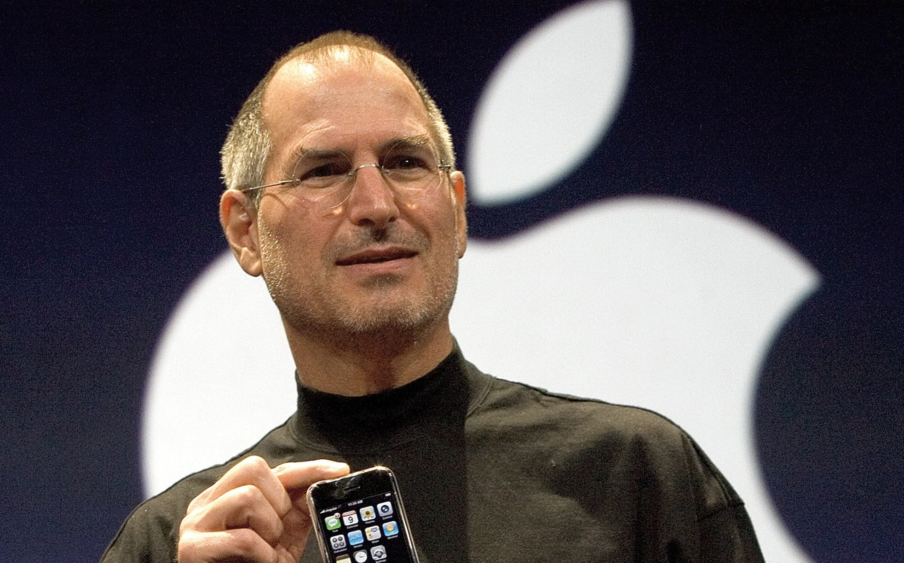
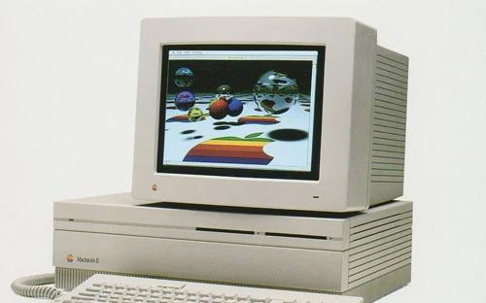
Steve Jobs was born in San Francisco at 1955
At 1976 april 1 he founded Apple, The First company who made smartphones and had colorful displays on their computers.

Slide 3


For somewhy he was banned for a time from apple and in that time he founded the company: Pixar. This company makes movies and its also really popular
And he also founded an other company: NeXT, specialized in computer workstations for higher educations and business markets

Slide 4
A little intresting thing also what im was mentioned earlyer, in 1985 Apples board belived for he wasnt ready for the CEO role of Apple, so they banned him and at that ime he founded that other two company
Also he had a little autism

Slide 5
Sources
Google
Wikipedia

Slide 6
Thanks For Watching!

